Slide 1
My Journey in Physical Science with Elementary Education Majors
Beth Marchant
Indiana University South Bend

Slide 2
Preparation - Me
B.S. Mechanical Engineering
5 years experience in Youth Ministry
3 years experience in residential treatment facility
6 years experience teaching HS Physics and Earth Science
9 years experience as a QuarkNet Staff Member
4 years experience as a Math Enrichment Specialist and Math Tutor
How hard can this be??
Notes:
After six years teaching high school physics, nine years as a QuarkNet staff member, and four years teaching as a consultant, I am currently teaching a three-credit-hour university course called “Physical Science for Elementary Teachers.” It is the only college-level physics and chemistry course that this group is required to take before entering the elementary school classroom full-time. In the course design and implementation of this lecture and lab course, I have combined research-based backwards design principles, some flipped instructional strategies, standards-based grading measures, and repeated assessment opportunities to enhance student learning. I will present data on my students’ learning outcomes in six major content areas, MOSART pre- and post-test results, and student course evaluation data.

Slide 3
Preparation - Them
Sophomore standing
Passed Math-T 101
Concurrent enrollment Math-T 102
Required to take:
Geol 190 – Earth and Space Science
BIO-T 105 – Biology for Elementary Teachers
PHYS-T 105 – Physical Science for Elementary Teachers

Slide 4
The Class
Lecture – 40 students once a week for 1 hour 50 minutes
Lab – 1 hour 50 minutes once a week – 24 & 16 students
That translates to 32 meeting times minus a lab for Thanksgiving Break

Slide 5
Getting Ready
Physical Science – all of high school and introductory college physics and chemistry tied in with Indiana Science Standards for grades K-6.
What’s important? Who to ask? How to narrow all of these great ideas down? Etc? Etc?
Designing with the end in mind
Grading
Syllabus
Oh, my!!!
Notes:
----- Meeting Notes (1/6/15 14:21) -----
Reactions from different groups
1) Physics and Chem
2) College of Ed
3) New Faculty Orientation

Slide 6
Physical Science
Talked to Physicists and Chemists, Physics and Chemistry Faculty and Teachers – “Good Luck!” with a smile and a wink, “We need elementary teachers to really know science!”
Talked to College of Education people - “They really can’t do all that much.”, “You can’t cover all of that – it’s too much!”
Went to New Adjunct Faculty Orientation – “Students will have many distractions – give them the opportunity to learn.”, “They don’t want to be treated like IU Bloomington lite.”

Slide 7
Grading
Standards-Based Grading (SBG) – we want our students to know XXX, so we let them work until they master XXX
What is “mastery”?
A person knows the material . . . When? How long? How much? What material?
A person knows most of the material at some later time . . . What if a person has a limited memory?
A person knows most of the material or can look it up and present it to others at a later time . . .

Slide 8
Grading
Events:
Had been following Dan Myer and Frank Nochese on Twitter for about 6 months – “if you are going to try SBG, just start on something, don’t wait until you have the perfect system or set-up”
Book from ASCD, Grading Smarter, Not Harder by Myron Dueck
My system is born – now I need a textbook order??

Slide 9
Grading
Standards-Based Grading
Mastery - A person knows 80% or more of the material now and can look it up later to present it when she or he begins to teach elementary school.
** In-class Midterm and Final exams to overcome potential cheating on on-line assessments
Notes:
----- Meeting Notes (1/6/15 14:21) -----
Want students to know X, then help them to learn X.

Slide 10
The Content Rubric
Objective | Not yet met (<60%) | Basic (60%) | Proficient (80%) | Beyond Proficient (> 90%) | Points Possible
Force and Motion | 0 | 40 | 80 | 90 | 80
Energy | 0 | 40 | 80 | 90 | 80
Electricity & Magnetism | 0 | 40 | 80 | 90 | 80
Nature of Light/Sound/Waves | 0 | 40 | 80 | 90 | 80
Atomic Structure & Chemical Reactions | 0 | 40 | 80 | 90 | 80
Explaining Matter through Elements, Atoms & Molecules | 0 | 40 | 80 | 90 | 80
Total Points |  |  |  |  | 480

Slide 11
The Skills Rubric
Objective | Not yet met | Basic | Proficient | Beyond Proficient | Points Possible
Demonstrates appropriate safety skills in laboratory | 0 |  | 60 | 90 | 90
Performs basic laboratory experiments to demonstrate physical science content | 0 | 30 | 60 | 90 | 90
Integrates mathematics in physical science content | 0 | 30 | 60 | 90 | 90
Communicates results of laboratory experiments by relating the results to the appropriate physical science concepts | 0 | 30 | 60 | 90 | 90
Can learn new science concepts based on previous knowledge | 0 | 30 | 60 | 90 | 90
Total Points |  |  |  |  | 450

Slide 12
My Textbook
Suggestion: “Try the National Science Teachers Association (NSTA) Learning Center.” I’ll hook you up with the contact there.
A bit hard to navigate but it takes care of the continuous and asynchronous testing availability that I want for my students.
Chose Major Topics from their modules:
Forces & Motion
Electric & Magnetic Forces
Energy
Nature of Light (waves and sound)
Atomic Structure
Explaining Matter with Elements, Atoms, & Molecules

Slide 13
The Syllabus
Fill in all the easy information in advance
Night before – assigned numbers to make out the rubrics – hoping that they work out
They did!! ☺

Slide 14
The Grading Scale
Grading System Points
Minimum Points | % | Grade
865 | 100-93 | A
837 | 92-90 | A-
809 | 89-87 | B+
772 | 86-83 | B
744 | 83-80 | B-
716 | 79-77 | C+
679 | 76-73 | C
651 | 72-70 | C-
623 | 69-67 | D+
586 | 66-63 | D
558 | 62-60 | D-
< 558 | < 60 % | F

Slide 15
Mentos
At New Faculty Orientation, “If I had a subject in which I could blow stuff up, I would do that on the first day.”
First Day – Diet Coke and Mentos – why not?

Slide 16
Preparation - Them
At least 1 had taken no science class ever
Most had taken HS Chemistry
Almost none had HS Physics
About 1/2 were comfortable with Algebra I
Age range – 20-40
Many working full-time
Most full-time class load
Most not “into” science or math – that’s why they are majoring in Elementary Education ☺
Notes:
----- Meeting Notes (1/6/15 14:21) -----
Dark Energy and Dark Matter

Slide 17
The Key
Who has to meet whose expectations: them or me?
Since they were coming to the course as a required course and needed a decent grade, it dawned on me that I was the one who would have to change.
Added layers of support
Natural since I have taught all levels
Unusual since many college faculty don’t generally do this

Slide 18
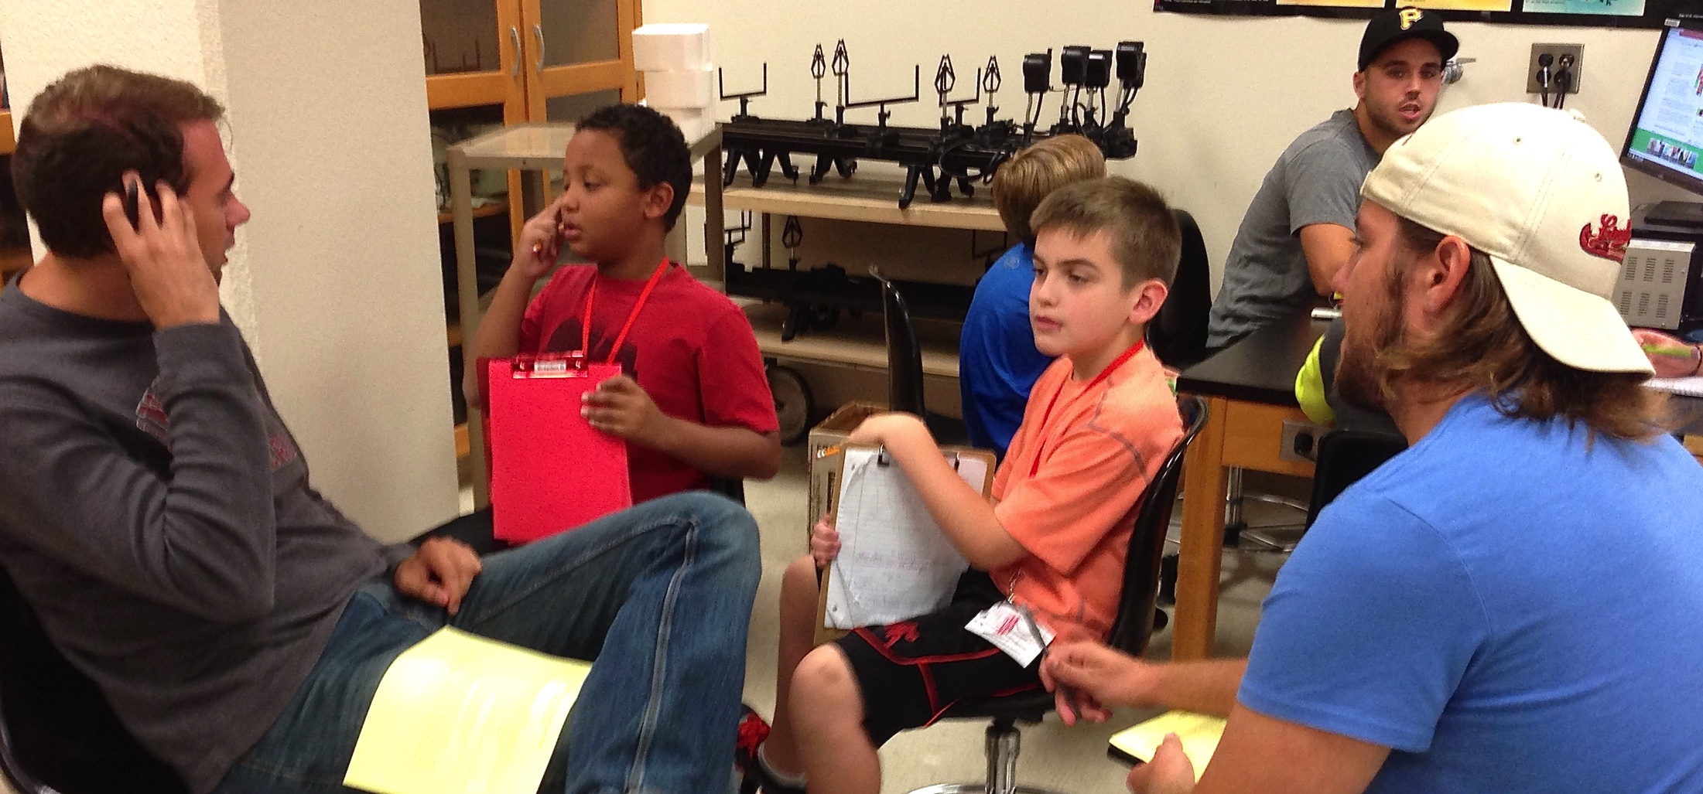
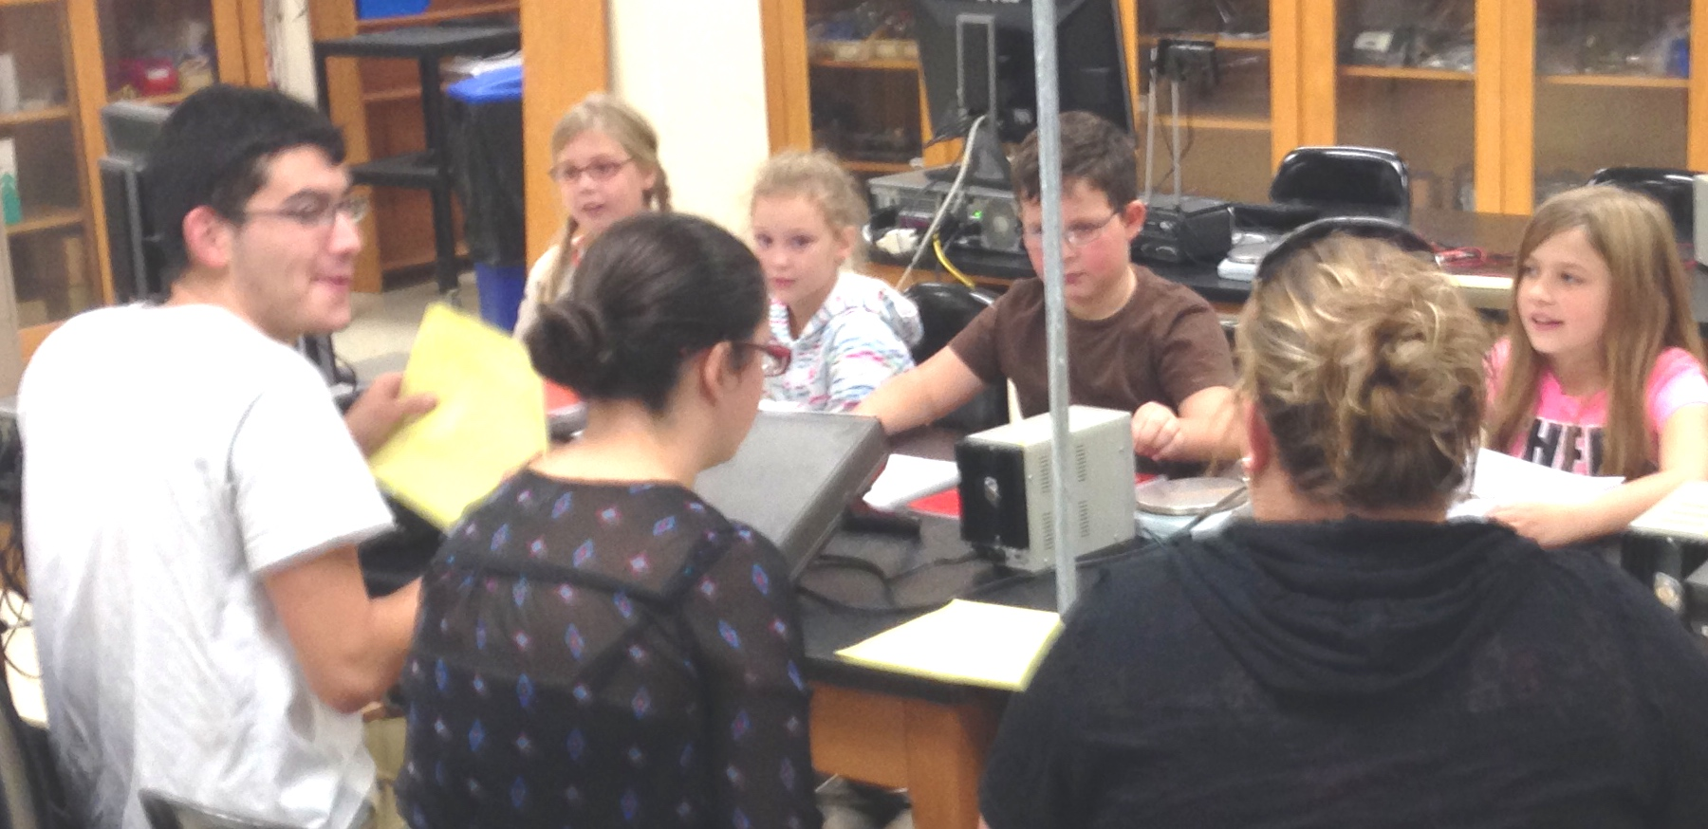
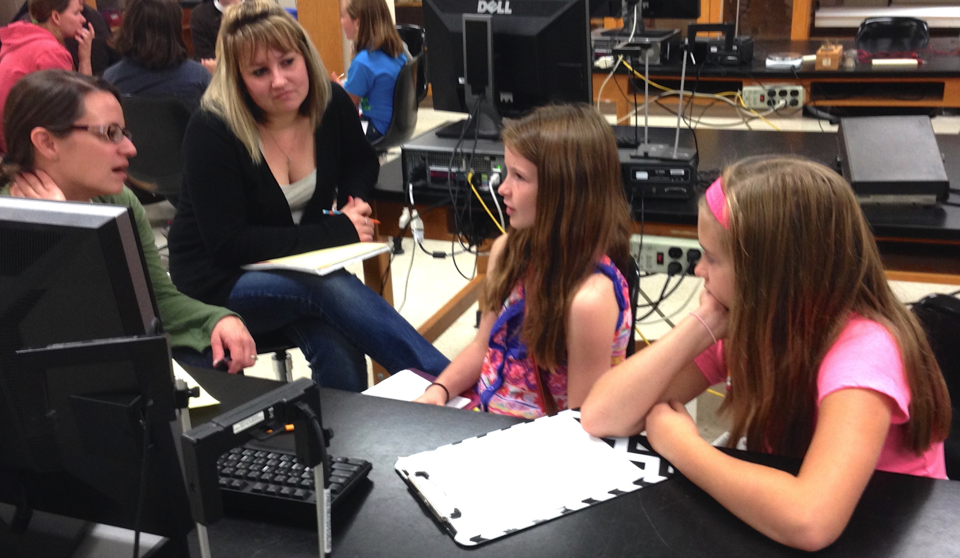

Slide 19
Outcomes
MOSART – Misconceptions-Oriented Standards-based Assessment Resources for Teachers
Student Grades
Student Evaluations
Notes:
----- Meeting Notes (1/6/15 14:21) -----
Next . . .

Slide 20
MOSART Results
Harvard University tests that “. . . probe for any conceptual shift(s) as a result of professional development activities, course work, or other intervention.”
Physical Science
Grades 5-6 – I chose this one based on my student population
Grades 7-8
Grades 9-12
(https://www.cfa.harvard.edu/smgphp/mosart/, 1/1/2015)
Notes:
----- Meeting Notes (1/6/15 14:21) -----
Pre- and post-tests available

Slide 21
MOSART Results
Based on 11 K-4 Science Standards from the National Science Education Standards
Items such as K-4 Physical Science Standard 6: “The position and motion of objects can be changed by pushing or pulling. The size of the change is related to the strength of the push or pull.”
There are test items that test for each of the 11 standards from 1-3 times with varying difficulty
Pre- and Post-test formats available with same questions in a different order

Slide 22
MOSART Results

Slide 23
MOSART Results
Average gains not statistically significant at 95% confidence level
Notes:
----- Meeting Notes (1/6/15 14:21) -----
Average
Areas where students improved

Slide 24
MOSART Results
Average gains not statistically significant at 95% confidence level
Notes:
----- Meeting Notes (1/6/15 14:21) -----
Areas where they did more poorly

Slide 25
MOSART Results
Stand- ard | Pre-test | Post-test
1 | 83% | 79% | “Objects have many observable properties, including size, weight, shape, color, temperature, and the ability to react with other substances. Those properties can be measured using tools, such as rulers, balances, and thermometers.”
2 | 40% | 66% | “Objects are made of one or more materials, such as paper, wood, and metal. Objects can be described by the properties of the materials from which they are made, and those properties can be used to separate or sort a group of objects or materials."
3 | 83% | 74% | “Materials can exist in different states—solid, liquid, and gas. Some common materials, such as water, can be changed from one state to another by heating or cooling."
4 | 80% | 72% | “The position of an object can be described by locating it relative to another object or the background.”
5 | 50% | 79% | “An object’s motion can be described by tracing and measuring its position over time."
6 | 65% | 62% | "The position and motion of objects can be changed by pushing or pulling. The size of the change is related to the strength of the push or pull.”
7 | 35% | 59% | “Sound is produced by vibrating objects. The pitch of the sound can be varied by changing the rate of vibration.”
8 | 55% | 69% | “Light travels in a straight line until it strikes an object. Light can be reflected by a mirror, refracted by a lens, or absorbed by the object."
9 | 59% | 64% | “Heat can be produced in many ways, such as burning, rubbing, or mixing one substance with another. Heat can move from one object to another by conduction."
10 | 60% | 64% | “Electricity in circuits can produce light, heat, sound, and magnetic effects. Electrical circuits require a complete loop through which an electrical current can pass."
11 | 65% | 55% | “Magnets attract and repel each other and certain kinds of other materials."
Notes:
Print out for me

Slide 26
MOSART Results
Stand- ard | Pre-test | Post-test
1 | 83% | 79% | “Objects have many observable properties, including size, weight, shape, color, temperature, and the ability to react with other substances. Those properties can be measured using tools, such as rulers, balances, and thermometers.”
2 | 40% | 66% | “Objects are made of one or more materials, such as paper, wood, and metal. Objects can be described by the properties of the materials from which they are made, and those properties can be used to separate or sort a group of objects or materials."
3 | 83% | 74% | “Materials can exist in different states—solid, liquid, and gas. Some common materials, such as water, can be changed from one state to another by heating or cooling."
4 | 80% | 72% | “The position of an object can be described by locating it relative to another object or the background.”
5 | 50% | 79% | “An object’s motion can be described by tracing and measuring its position over time."
6 | 65% | 62% | "The position and motion of objects can be changed by pushing or pulling. The size of the change is related to the strength of the push or pull.”
7 | 35% | 59% | “Sound is produced by vibrating objects. The pitch of the sound can be varied by changing the rate of vibration.”
8 | 55% | 69% | “Light travels in a straight line until it strikes an object. Light can be reflected by a mirror, refracted by a lens, or absorbed by the object."
9 | 59% | 64% | “Heat can be produced in many ways, such as burning, rubbing, or mixing one substance with another. Heat can move from one object to another by conduction."
10 | 60% | 64% | “Electricity in circuits can produce light, heat, sound, and magnetic effects. Electrical circuits require a complete loop through which an electrical current can pass."
11 | 65% | 55% | “Magnets attract and repel each other and certain kinds of other materials."
Notes:
Print out for me

Slide 27
MOSART Results

Slide 28
MOSART Results

Slide 29
Grades

Slide 30
Student Evaluations – Lecture*
Question | Excellent [1] | Good [2] | Fair [3] | Poor [4] | Mean | Mode
Overall, how would you rate this course? | 12 | 18 | 1 | 1 | 1.72 | Good
Overall, how would you rate the instructor? | 20 | 11 | 1 | 0 | 1.41 | Excellent
* 80% Response Rate

Slide 31
Student Evaluations – AM Lab*
Question | Excellent [1] | Good [2] | Fair [3] | Poor [4] | Mean | Mode
Overall, how would you rate this lab course? | 12 | 8 | 0 | 0 | 1.40 | Excellent
Overall, how would you rate the instructor? | 13 | 6 | 1 | 0 | 1.40 | Excellent
* 83% Response Rate

Slide 32
Student Evaluations – PM Lab*
Question | Excellent [1] | Good [2] | Fair [3] | Poor [4] | Mean | Mode
Overall, how would you rate this lab course? | 7 | 4 | 1 | 0 | 1.50 | Excellent
Overall, how would you rate the instructor? | 9 | 3 | 0 | 0 | 1.25 | Excellent
* 75% Response Rate

Slide 33
Student Evaluations
Areas for Improvement
Objectives not clear to all
Course not difficult enough to be stimulating for some
Text (NSTA Learning Center) not rated highly – from comments mostly due to interface
Instructor not well organized

Slide 34
Spring, 2015 and beyond
Things to Keep
Standards-based Grading
Unlimited opportunities for reassessment
Rubrics
Content Areas
Notes:
----- Meeting Notes (1/6/15 14:21) -----
Spring, 2015 - a week from tomorrow

Slide 35
Spring, 2015 and beyond
Things to Reconsider
Which text – on-line with multiple opportunities for assessment
Amount and placement of chemistry
Level of mathematical proficiency required

Slide 36
Spring, 2015 and beyond
Things to Follow Up On
CWSEI Teaching Practices Inventory
Took it and scored at top end of reported departmental averages
Wieman C, Gilbert S (2014). The teaching practices inventory: a new tool for characterizing college and university teaching in mathematics and science. CBE Life Sci Educ 13, 552–569.

Slide 37
Any Questions??
Contact info:
Beth Marchant
Indiana University South Bend (IUSB)
bamarcha@iusb.edu
Note: These slides will be submitted to AAPT be uploaded – there are many “hidden” slides included in the presentation that may be of further interest to you.
Notes:
----- Meeting Notes (1/6/15 14:21) -----
Thank you!

